Slide 1


NoDEO
Idea Pitch
Profile precision
Team members :
Harsh Anand
Harish Ramaswamy
Hrithik Verma
Md Zaid

Slide 2


NoDEO
List Of Contents
Agenda
Campaign Goals
Schedule & Deadlines
Impending Issues
Flowchart and Tech-Stack
On-Demand Integration

Slide 3

NoDEO
Page 1
Problem Statement
Campaign Goals
In a world where digital footprints shape perceptions and decisions, determining a person’s personality, preferences, and behavior from their social presence is critical in applications such as hiring, dating, and targeted marketing is difficult. Current profiling methods are often inefficient, lacking the ability to integrate diverse data sources and provide a reliable, comprehensive assessment. This limitation results in fragmented insights that fail to capture the holistic characteristics of individuals, leading to suboptimal matchmaking, hiring, and customer targeting outcomes.
Goal One
Goal Two
Goal Three
Matrimonial and Compatibility Matching: Leverage AI-driven personality summaries to assist in finding compatible partners. By analyzing shared interests, lifestyle patterns, and personal traits, the system enhances the matchmaking process for better compatibility.
Transforming HR and Hiring: Use our technology to change the way HR interviews work, offering in-depth insights into candidates’ personalities, values, and behaviors based on their online presence. This tool helps HR teams assess cultural fit and character beyond resumes, providing a holistic view of each candidate.
Customer Targeting for Businesses: Enable businesses to identify their ideal customers by profiling leads through their social media interests, hobbies, and brand engagement. By understanding potential customers' preferences, businesses can target and tailor marketing efforts to connect with those most likely to resonate with their brand.

Slide 4

NoDEO
Page 2
Future Roadmap
Schedule & Deadlines
Step 1
Step 3
Implementation of Data Acquisition Techniques: Develop and implement web scraping methods to gather relevant social media data while ensuring compliance with privacy regulations and data usage policies.
Model Development: Build and refine the AI models that will analyze the collected data to generate personality summaries and insights.
Step 3
Step 4
Preliminary groundwork has been established for the project, including initial research into AI capabilities for personality profiling and a comprehensive overview of data sources for web scraping. Key sources identified for data acquisition include Instagram, LinkedIn, Netflix, Spotify, and other relevant social media platforms. Additionally, a risk analysis and challenge assessment have been completed to identify potential hurdles and develop mitigation strategies. This technical groundwork will support our integration efforts and inform the design of the system.
Integration of OnDemand APIs: Seamlessly incorporate OnDemand’s API capabilities to enhance data processing, model deployment, and overall functionality.
Testing and Validation: Conduct thorough testing of the system to ensure accuracy and reliability of the insights generated, followed by user feedback sessions to make necessary adjustments before the final rollout.

Slide 5
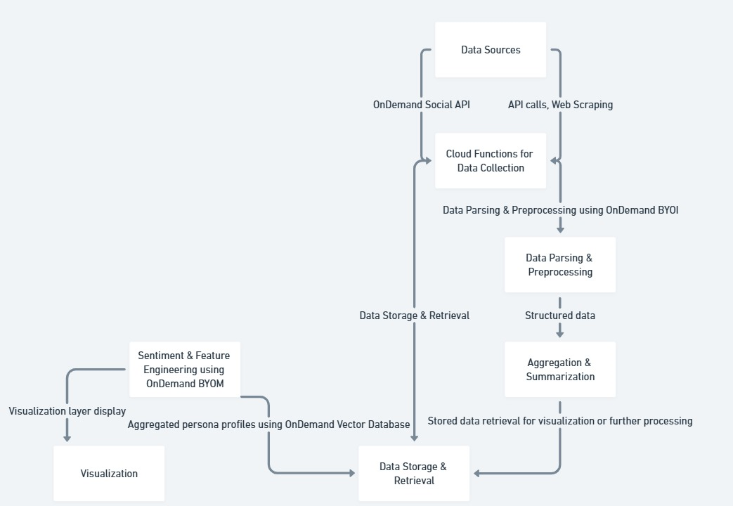
NoDEO
Page 3
How our idea Works

Slide 6
NoDEO
Page 4
Problem | Proposed Solution
Algorithm Bias and Fairness: Ensuring fairness in personality profiling and matchmaking algorithms is vital. There’s a risk that the models may unintentionally favor specific demographics, leading to unequal treatment. | To mitigate this challenge, we will leverage OnDemand's capabilities to access a diverse range of data sources, ensuring that our algorithms are trained on a broad spectrum of user profiles. By employing ongoing bias detection techniques and incorporating feedback loops, we aim to create a more balanced and inclusive matchmaking process that respects the diversity of our user base.
Incentivizing Data Sharing: Users often hesitate to share their personal data due to a lack of perceived benefits. | We will clearly communicate the advantages of data sharing, emphasizing that providing more information leads to better matches and increased visibility on platforms, making users more likely to engage.-
Data Privacy Issues: There are significant concerns about who has access to the input and output data, which can deter users from participating. | We will develop a robust privacy framework that includes a clear privacy policy. This policy will ensure transparency about data usage and incorporate consent-based data sharing mechanisms to build trust among users.
Managing Project Complexity: The scale and intricacy of the project can be daunting, posing challenges in execution and management. | To address this, we will leverage OnDemand.io’s API solutions, which provide robust infrastructure and support for managing complex data operations efficiently.
Impending
Issues
As we navigate the complexities of our project, several key challenges need to be addressed to ensure successful implementation. These challenges include limited data availability from certain user groups, issues surrounding data sharing incentives, privacy concerns, and the overall management of a large-scale initiative. Below are the specific challenges and our proposed solutions:

Slide 7
NoDEO
Page 5
On-Demand
Integration
Data Collection Agents
BYOI & BYOM Flexibility
OnDemand agents efficiently pull public data from sources like Twitter, Instagram, and Spotify, ensuring a steady stream of relevant insights into user interests and behaviors.
With OnDemand's Bring Your Own Inference and Model options, we integrate our models effortlessly, tailored to each platform's specific data format and needs.
Efficient Data Management
Scalability & Security
Preliminary groundwork has been established for the project, including initial research into AI capabilities for personality profiling and a comprehensive overview of data sources for web scraping. Key sources identified for data acquisition include Instagram, LinkedIn, Netflix, Spotify, and other relevant social media platforms. Additionally, a risk analysis and challenge assessment have been completed to identify potential hurdles and develop mitigation strategies. This technical groundwork will support our integration efforts and inform the design of the system.
OnDemand’s file management and vector database organize and store data seamlessly, supporting fast and organized access for accurate profile generation.
The scalable, secure architecture of OnDemand supports growth across applications like matrimonial, recruitment, and customer targeting.

Slide 8
NoDEO
Thank You!
End of Presentation

